Slide 1
A Christmas Miracle
Michael O'Donnell

Slide 2


Problem Definition
IDEAL
Santa's workshop is well focused on the primary business outcome of preparing 100% of toys by Christmas Eve.
REALITY
Elven workforce has been overwhelmed with customer service requests in the run up to Christmas.
CONSEQUENCE
Santa has had to pull 1,000 elves from production onto customer support. As a result, production lines are 10% behind schedule and rising.

Slide 3
Analysis of Customer Service Requests
79%
Naughty or Nice List query
13%
Letter received confirmation request
5%
Belief in Santa complaint
3%
Change of mind application

Slide 4
Quantifying the Problem
One unionized elf costs $15 per hour in 2019
Currently, the average ticket resolution time is 30 minutes for one elf ($7.50 per ticket)
At the current rate of 12 million tickets per day, this is a daily running cost of $90m to Santa’s workshop
In addition to production delays, and the high costs of customer service ticket handling, 80% of children
have reported that they are dissatisfied or very dissatisfied with the support that they received from Santa’s
Workshop. Finally, 70% of customer support elves themselves report that they are dissatisfied or very dissatisfied
with their job.

Slide 5
Success Metrics
PRIMARY
Reduce the number of daily customer support tickets by 50% (12m to 6m)
Reduce the average ticket resolution time from 30 minutes to 5 minutes ($1.25 per ticket)
Reduce the daily running cost of customer service from $90m to $7.5m
SECONDARY
Improve customer satisfaction of handling of customer service tickets by reducing the number of children
reporting that they are unsatisfied down to 20%.
Improve agent satisfaction of handling of customer service tickets by reducing the number of elves
reporting low job satisfaction down to 20%. Agent turnover may be an additional metric to consider here.

Slide 6

Assumptions
Naughty or Nice List queries can be significantly reduced by providing detailed information on Frequently Asked Questions.
Not all queries can be eliminated. By providing live chat capability with customer support elves, the average ticket resolution time can be significantly reduced.

Slide 7
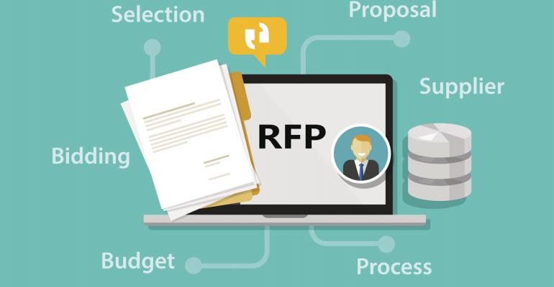
High Level Requirements
ADAPTABLE
Santa’s workshop is consistently changing, with new helpers and
processes every day.
SCALABLE
The customer service solution needs to work at enormous scale and allow for future innovation such as internal custom apps.
TRANSPARENT
Agents need to be able to see critical user information such as their name and which list they are on.
FAST
These users have short attention spans. Some customer support functionality, such as chat, needs to be real-time.
LAYERED
In the future, the organization may require a gated phone support line for parents.
MEASURABLE
The organization requires a feedback mechanism to assess the effectiveness of their customer service platform.

Slide 8
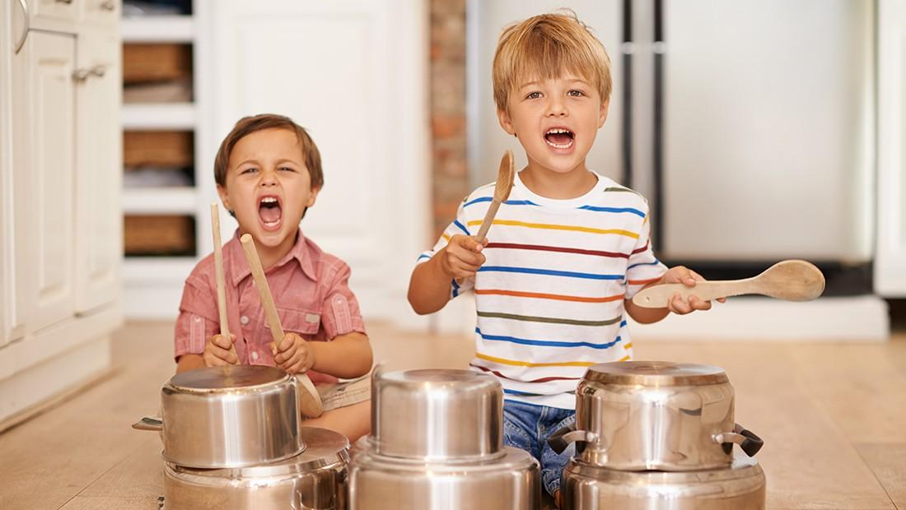
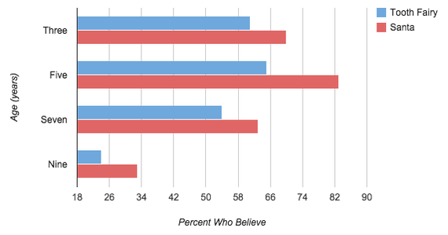
Personas
Kids between the ages of five and nine who still believe in Santa. Broad range of tech savviness, but largely proficient in using mobile apps. Roughly a 50/50 split between male and female.
Their mental mindset is typically anxious in the run-up to Christmas with concerns regarding whether they’re going to receive their Christmas present being at the forefront of their minds.
These users are likely to be using their parents’ device, so requesting the user to authenticate may be laborious for them.

Slide 9

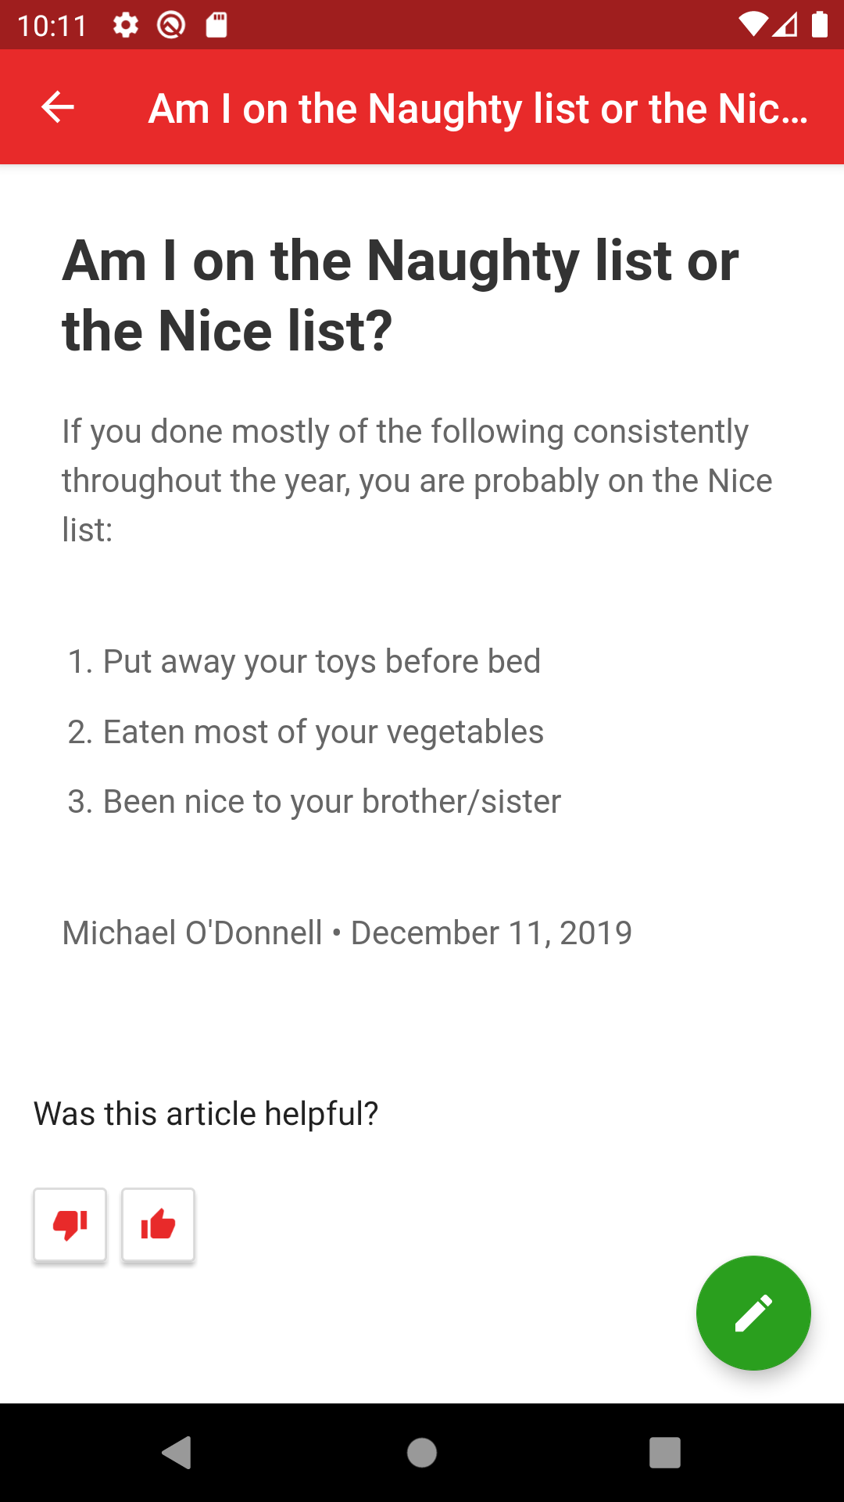
The Solution
A Santa Support app, integrated with Zendesk’s Support and Chat Mobile SDKs, that:
Provides detailed answers in response to Frequently Asked Questions.
Provides direct chat capability
Provides a direct path for the end-user to open customer service tickets in an efficient manner.
Automates the responses to high frequency customer service requests, liberating the Elven workforce to re-focus on the job at hand.

Slide 10
DEMO

Slide 11
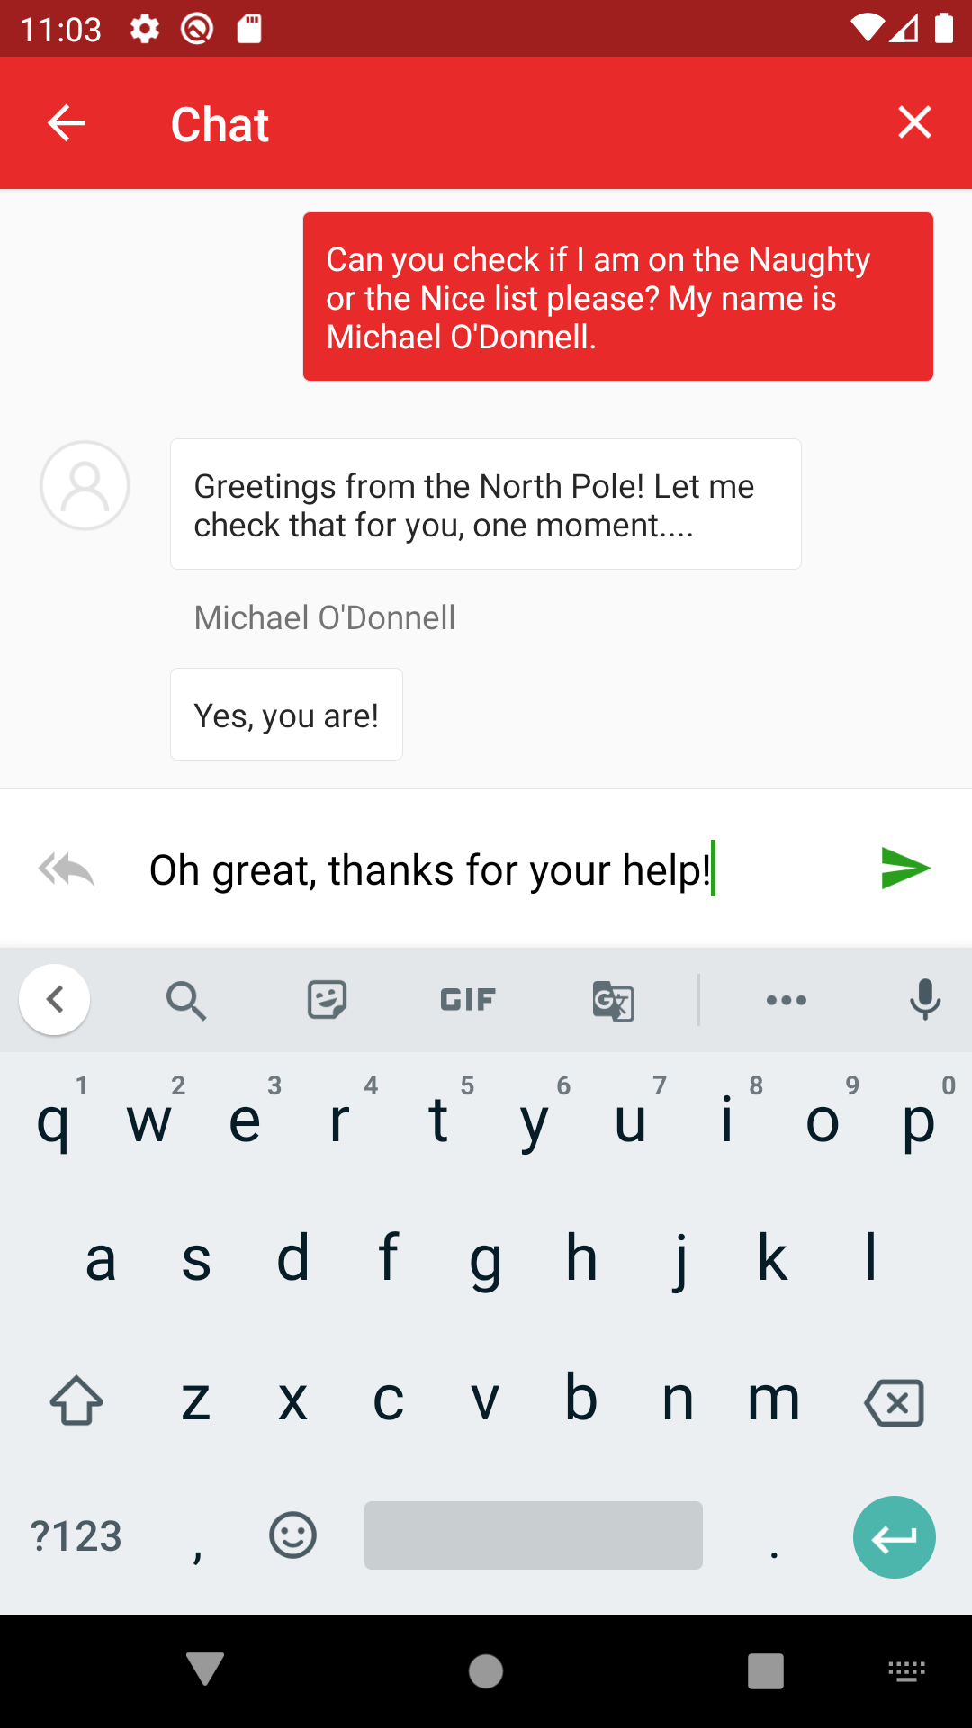
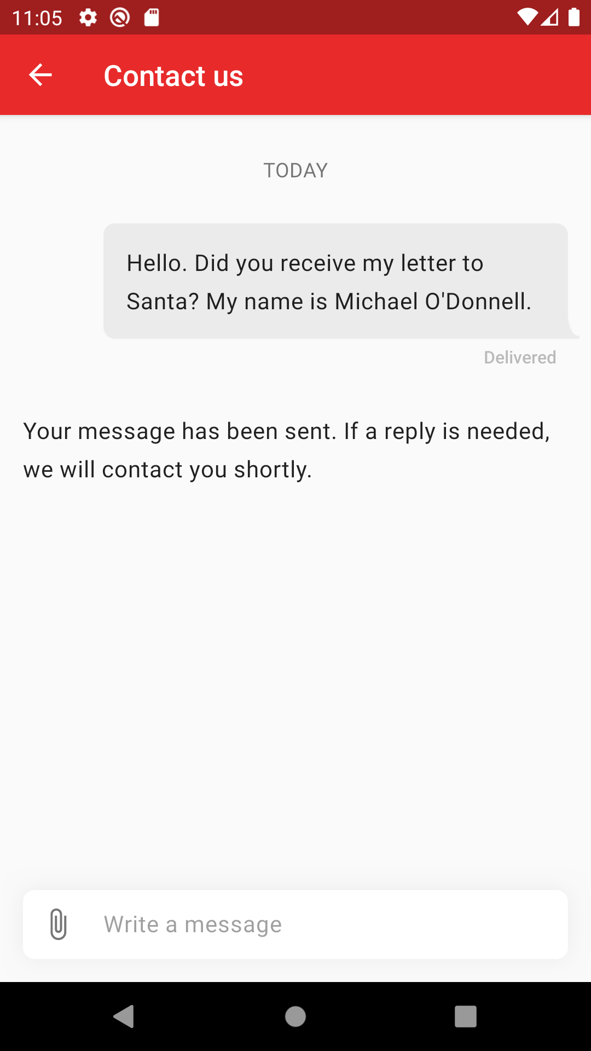
Help Center
Live Chat
Open Tickets + Auto Elf

Slide 12
Help Center
INTEGRATION
Directly integrated via the Zendesk Support Mobile SDK.
CONFIGURATION
Implemented as an "intent" as the Help Center would not be displayed straight away.
Customized the Help Center with the look and feel of the app itself.
Do not require authentication.

Slide 13
Live Chat
INTEGRATION
Directly integrated via the Zendesk Chat Mobile SDK.
CONFIGURATION
Implemented as an "intent" as the Live Chat would not be displayed straight away.
Require the name of the user, during pre-chat, so that agents can see critical user information.

Slide 14
Open Tickets + Auto Elf
INTEGRATION
Directly integrated via the Zendesk Support Mobile SDK.
Directly integrated via the Zendesk Answer Bot SDK.
CONFIGURATION
Implemented as an "intent" as the Open Tickets screen would not be displayed straight away.
Enable Answer Bot to suggest relevant FAQ articles which may help the user while they are waiting for a reply.

Slide 15
The Business Outcome
30 Minutes
5 Minutes (-83%)
Average Ticket Resolution Time
12m
6m (-50%)
The number of tickets opened daily
$90m
$7.5m (-91.67%)
Daily running cost of Santa’s Customer Service divison

Slide 16
The Business Outcome
80%
20% (-75%)
% of dissatisfied (or very dissatisfied) children
70%
35% (-50%)
% of customer support elves themselves report that they are dissatisfied or very dissatisfied
with their job

Slide 17

Future Improvements
Enable the organization to develop their own customer service applications, which can bring greater efficiencies and cost reduction moving forward.
For example: Allowing agents to see detailed information relating to the end-user may assist them in achieving faster and more effective ticket resolutions.
A layered solution, in which parents are also able to contact customer service on different channels (such as phone support) may result in a higher rate of customer satisfaction following ticket closures.

Slide 18
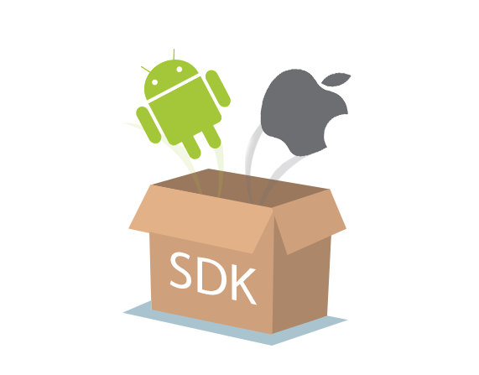
Recommendations for Improvement
Zendesk Support Mobile SDK
Advanced ticket functionality, such as “Split Ticket” or “Merge Ticket” may be useful for custom CS apps and for the Zendesk Support app.
Provide helpful articles within the RequestActivity itself – bring relevant information into conversation sooner and in a more automated manner (partial addressed via the Answer Bot).
Possibly review the naming convention of the RequestActivity and consider something more closely related to Support or Tickets.

Slide 19
Recommendations for Improvement
Zendesk Chat Mobile SDK
Capability to provide pre-chat information dynamically – possibly a combination of pre-defined (name, email, etc.) and dynamic (country, age, etc.) fields.
Allowing the agent to see whether the user is typing may be useful (today only the user can see if the agent is typing).
VisitorInfo object is required, but possibly not necessary when no customer information is provided.

Slide 20
Recommendations for Improvement
Zendesk Answer Bot SDK
More of a question – Is it possible that the Answer Bot capabilities could be used in the context of chat solutions, as well as the Support SDK?

Slide 21
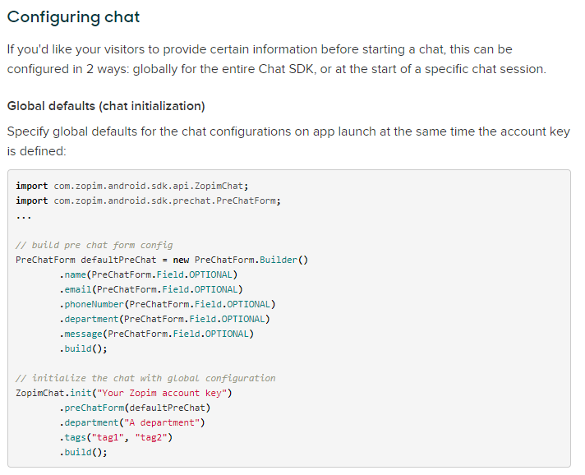
Possible Technical Improvements
Could potentially be more dynamic

Slide 22
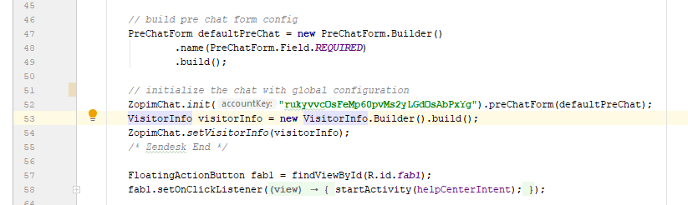
Possible Technical Improvements
Possibly not necessary when no customer information is provided

Slide 23
Thank You!
Q & A

